Slide 1
Merchant Onboarding

Slide 2

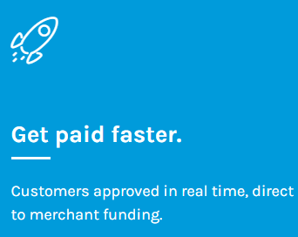
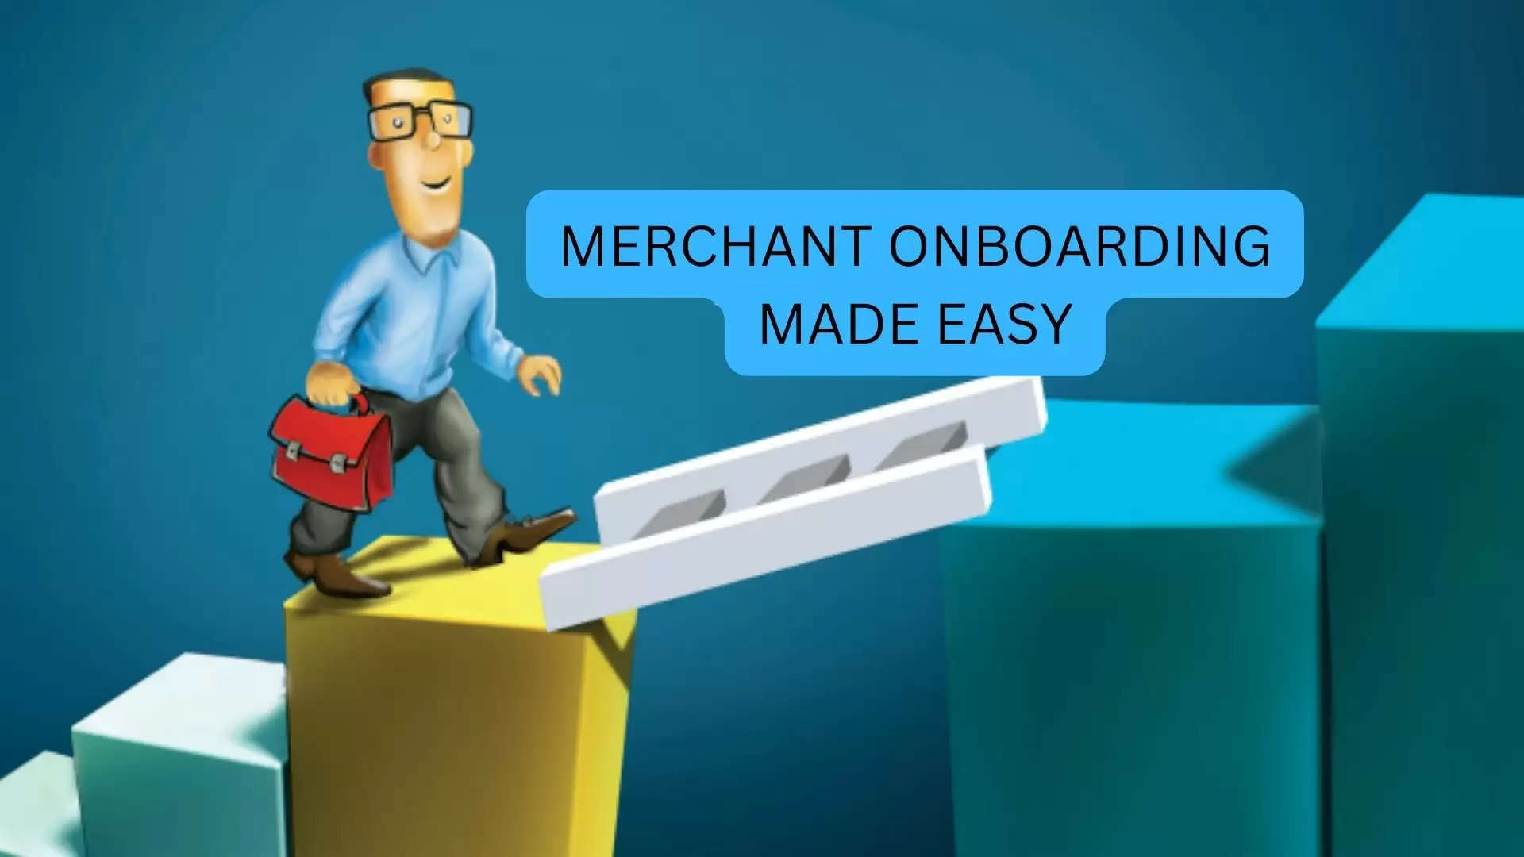
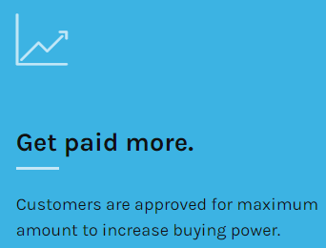
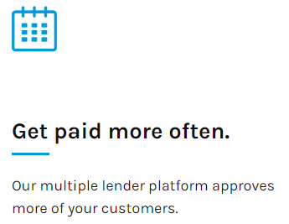
What’s exciting?

Slide 3
Why choose FinMkt?
Highly Customizable
We can work with merchants across industries and seamlessly integrate with a variety of POS software and ecommerce platforms.
Easy and Secure
Our underwriting process makes offering financing easy and safe. We will never sell personal data, of you or your customers.
Attractive Offers
You have the power to choose the lenders you want to work with and the best financing programs for your business and customers.
Reporting & Analysis
Our merchant portal provides you with data and insights you can use to improve your business.

Slide 4
How it Works
01. Customer applies.
At the time of sale, your customer completes one universal loan application with the ability to receive financing offers without it affecting their credit.
02. Customer chooses an offer.
In real-time, your customer is presented with offers for the maximum approval amount, compares rates and terms then chooses an offer.
03. You complete your sale.
After selecting an offer, your customer buys with confidence knowing the financing is in place for the purchase.

Slide 5
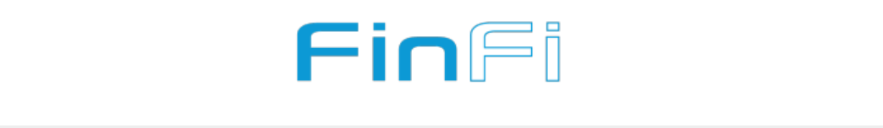
How to Onboard as Merchant?
finfi.co/merchant-onboard
Start Growing Your Business Today
Provide a few quick details below to get started!
Before You Apply
We do not provide financing for legal services or home security resellers.
Click here to see what criteria we consider when reviewing merchant applications.
A non-refundable merchant underwriting fee of $150 is required for all merchant applications submitted to FinMkt. This underwriting fee is payable upon application by credit card or ACH and applies regardless of whether a merchant's application is approved.

Slide 6
Before Merchant Applies, considerables.
Outstanding financial obligations including liens, judgments, and bankruptcy
Business license and/or trade license inactive, not in good standing, or revoked
Criminal history
Current/active lawsuits or litigation
Time in business is less than 10 months

Slide 7
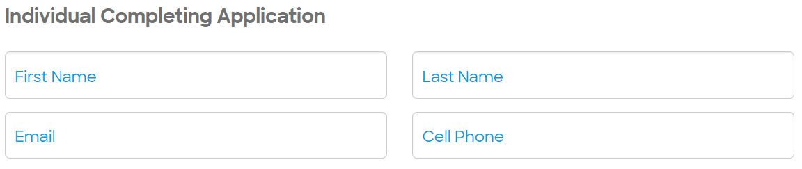
Fill in the Application
Fill the First and Last Names as per valid ID to avoid delays.
Working email and Cell Numbers can avoid delays in the process.

Slide 8
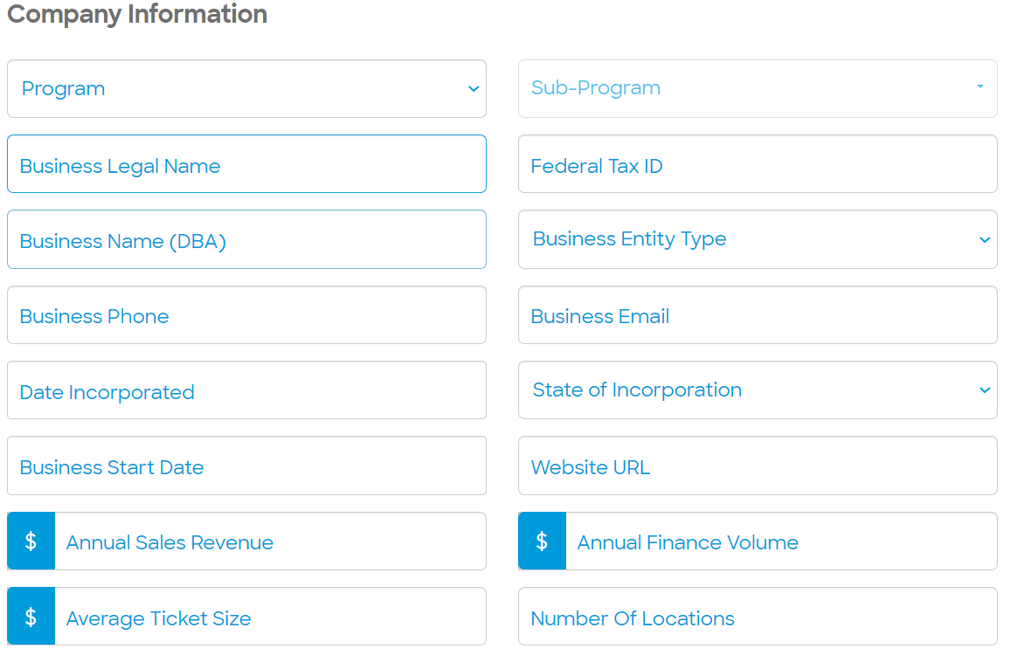
Fill in the Application
Home Improvement
Medical
Retail
Plumbing
HVAC
Solar
Landscaping
Flooring
Electrical
Roofing etc

Slide 9
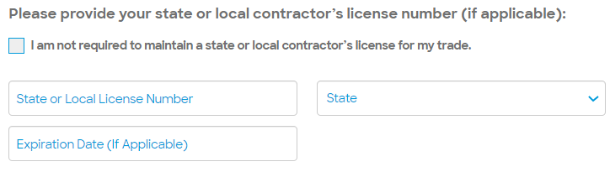
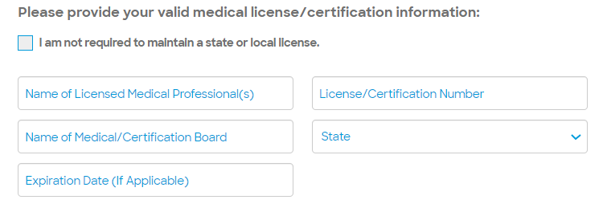
Licenses
Home Improvement
License Requirements Change based on the ‘Program’ merchant selects.
Home Improvement and Medical Practitioners – Home improvement merchants need to provide Local contractor’s License number if the state makes it mandatory to provide one.
Example: Illinois contractor licensing is generally handled at the local level. As long as you do not work in plumbing and roofing, you do not need to have a state-level license to work in Illinois.
Medical

Slide 10
Fill in the Application
Business Legal Name: The Name that is Legally registered
Federal Tax ID: Merchant’s TIN
Business Name (DBA): The name with Merchant Doing Business As
Business Phone: The number that is used for the business.
Business Email: The email that is used for the business.
Date Incorporated: The date when the business has incorporated.
State of Incorporation: In which state of the US the business.
Business Start Date: The date when the business has started.
Website URL: The URL of the company’s website.
Annual Sales Revenue: How much does the company make annually.
Annual Finance Volume: How much the does the company make through finance.
Average Ticket Size: What is the average size of each deal.
Number Of Locations: At how many locations does the merchant has business.

Slide 11
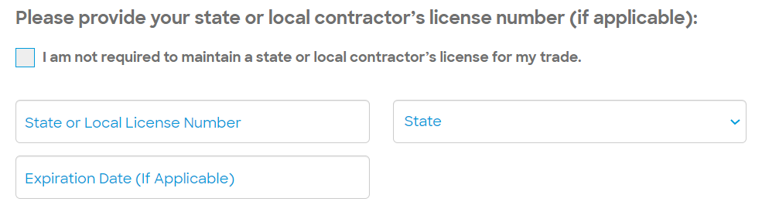
Fill in the Application
Merchant fills the details of licenses.
Clicks check box if merchant doesn’t need to maintain contractor’s license as the rules vary from state to state and city to city.

Slide 12
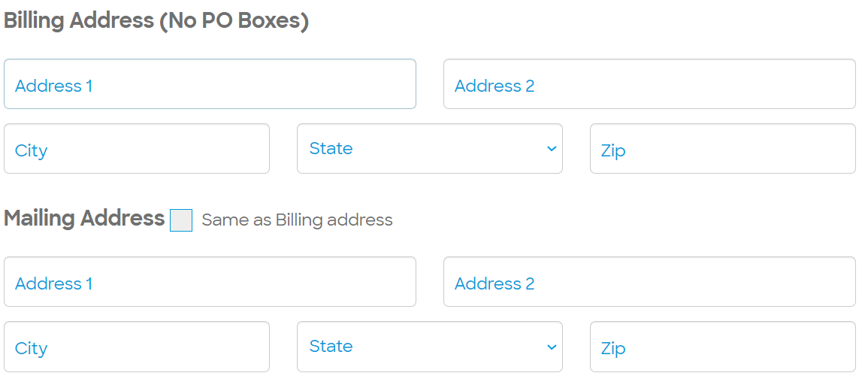
Fill in the Billing address in the given columns.
Click on check box if the Mailing Address is same as Billing Address.

Slide 13
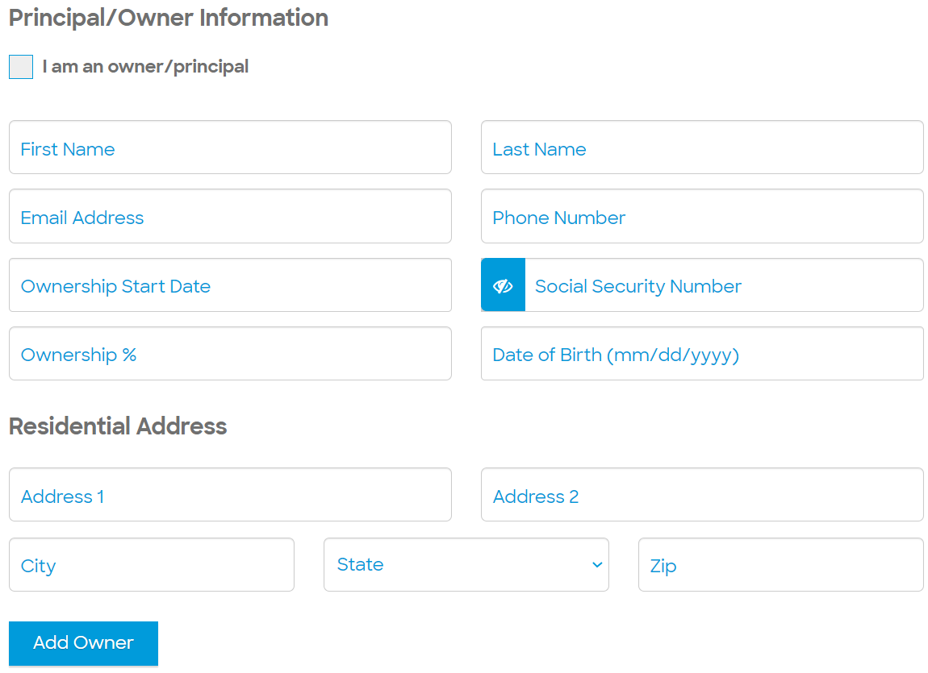
Fill in the information in all the columns. (if merchant is the owner by clicking on the checkbox.)
Use “Add Owner” if the owner is a different person.

Slide 14
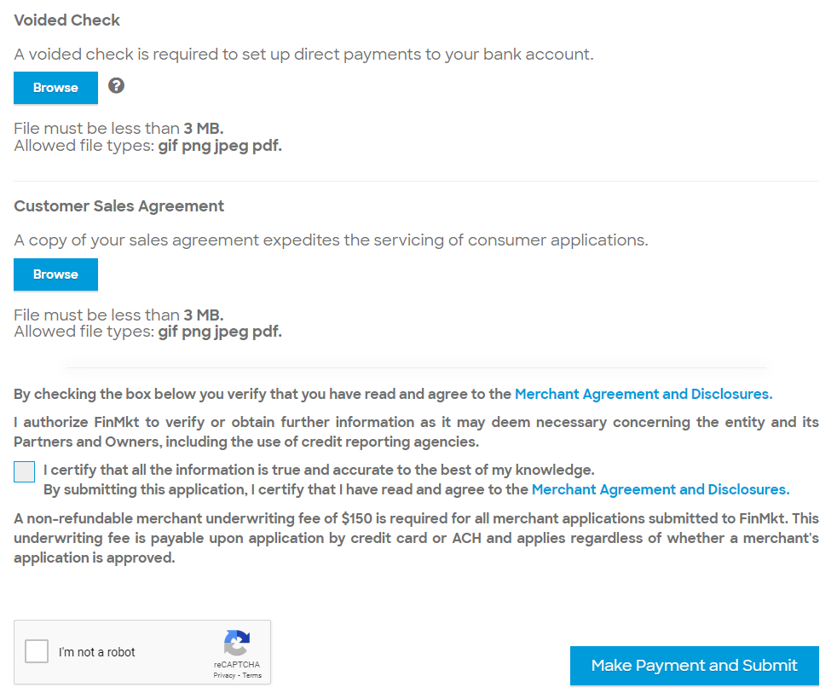
Merchant needs to provide an image of a voided check to set up direct payments to the merchant bank account.
Merchant needs to provide an image of the “Customer Sales Agreement” to expedite the consumer supplication process.
Click on the check box and ‘reCAPTCHA’ after carefully reading the Merchant Agreement and Disclosures
Proceed with Make Payment and Submit.

Slide 15
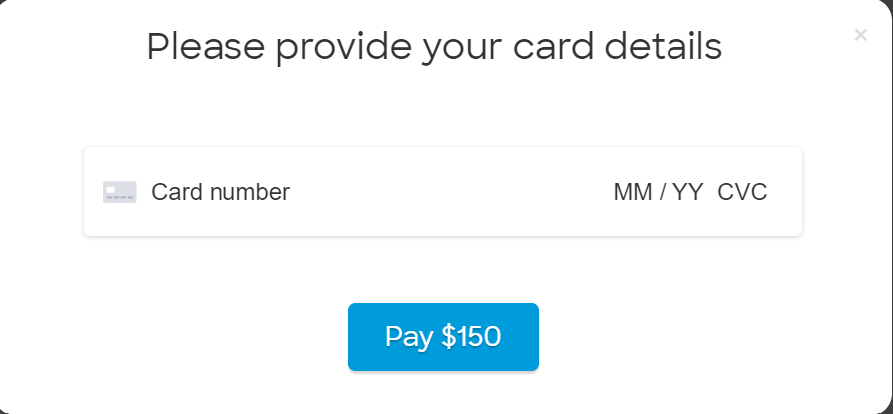
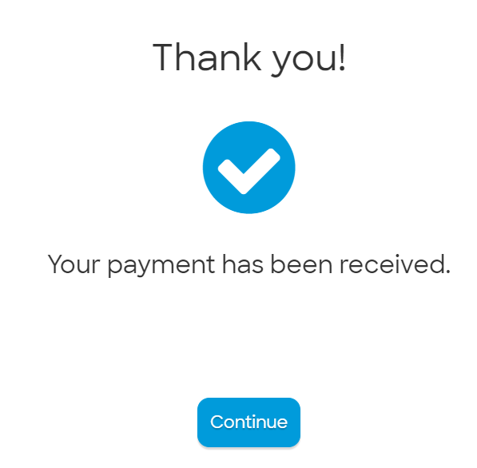
Merchant Fee
It will ask for card details to proceed for payment.
Merchant Fee changes based on the relationship with the Referral Partner. Merchant pays depending on a lot of other factors like coupons and discounted prices etc. The amount would be up to $150.
After successful payment there will be a ‘Thank you’ pop up appears.
Merchant then clicks on ‘Continue’

Slide 16
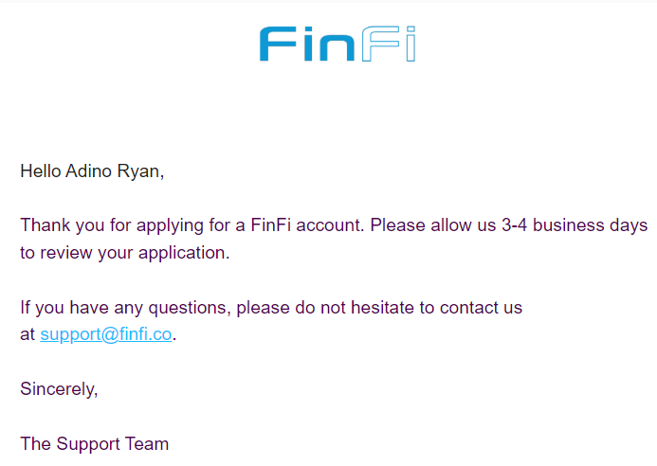
After the payment merchant receives an email from Finfi.

Slide 17
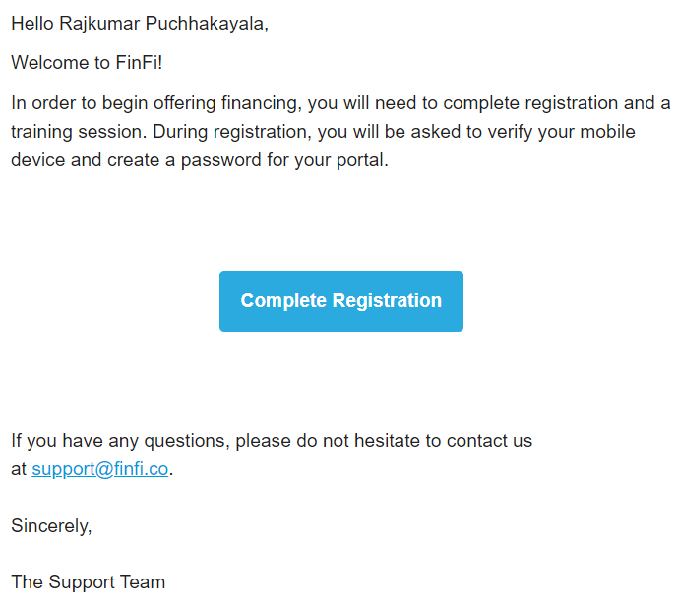
After the approval
After reviewing the merchant’s profile. An email is sent to the Merchant to ‘Complete Registration’.

Slide 18
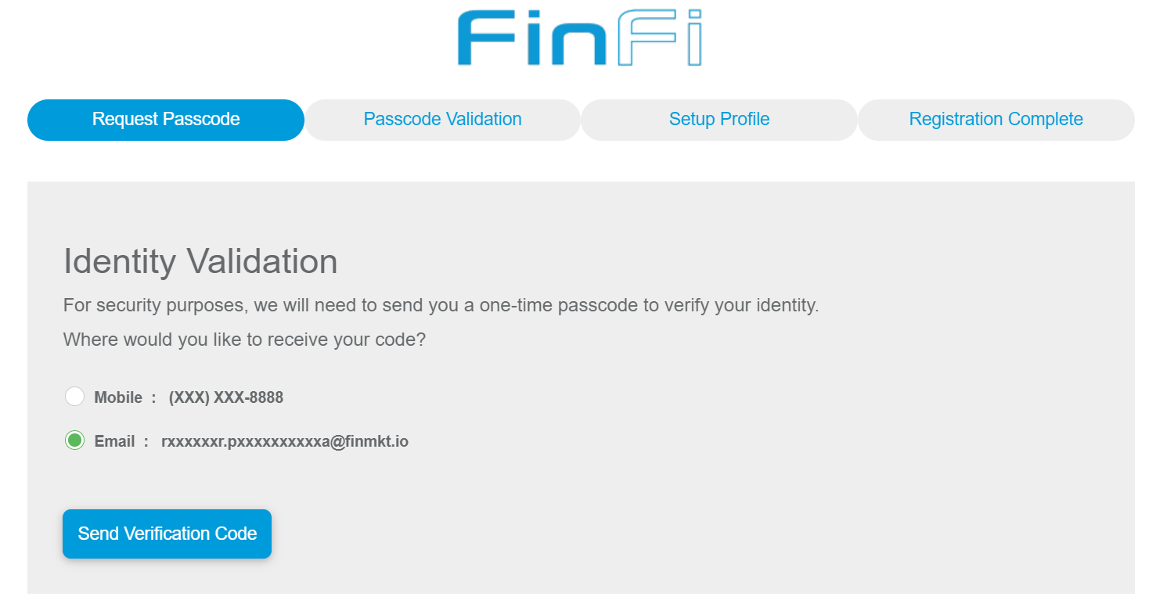
Request Passcode
Request Passcode: This will send an OTP

Slide 19
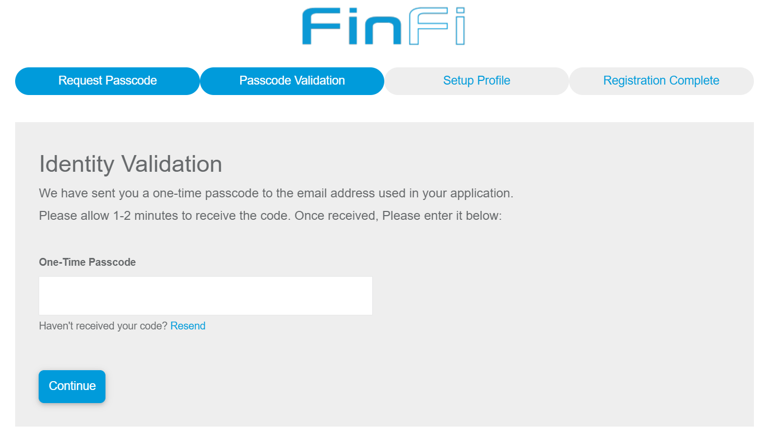
Passcode Validation
Passcode: Enters OTP that is sent to the phone or email. Clicks on ‘Continue’.

Slide 20
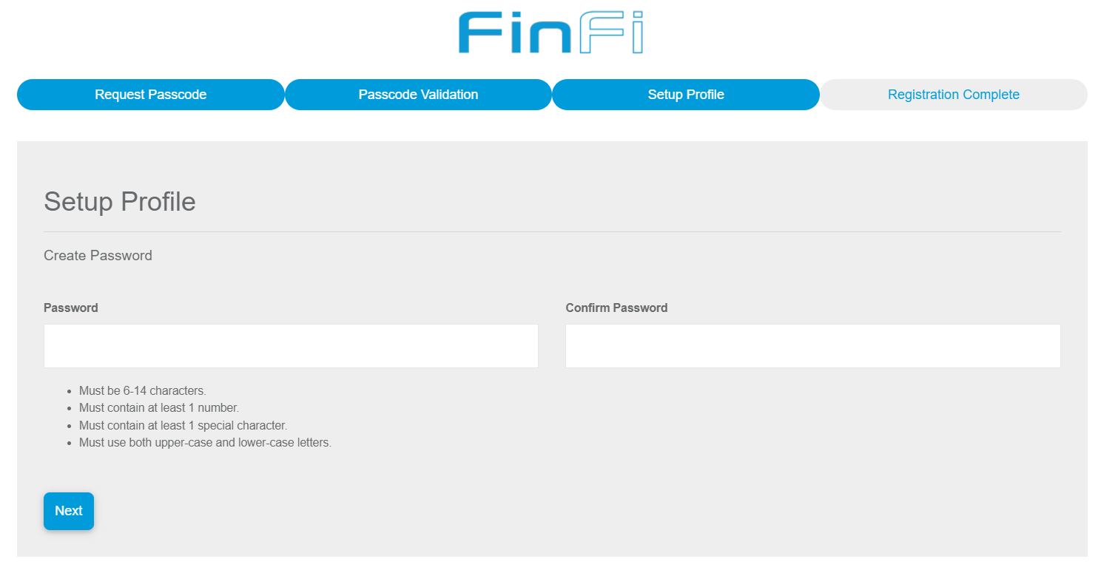
Set Up Profile
Creates new password.

Slide 21
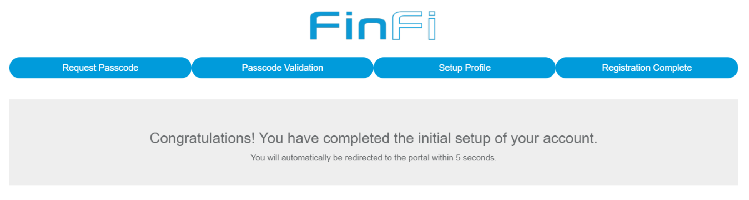
Registration Complete
It gets redirected to the Merchant Portal.

Slide 22
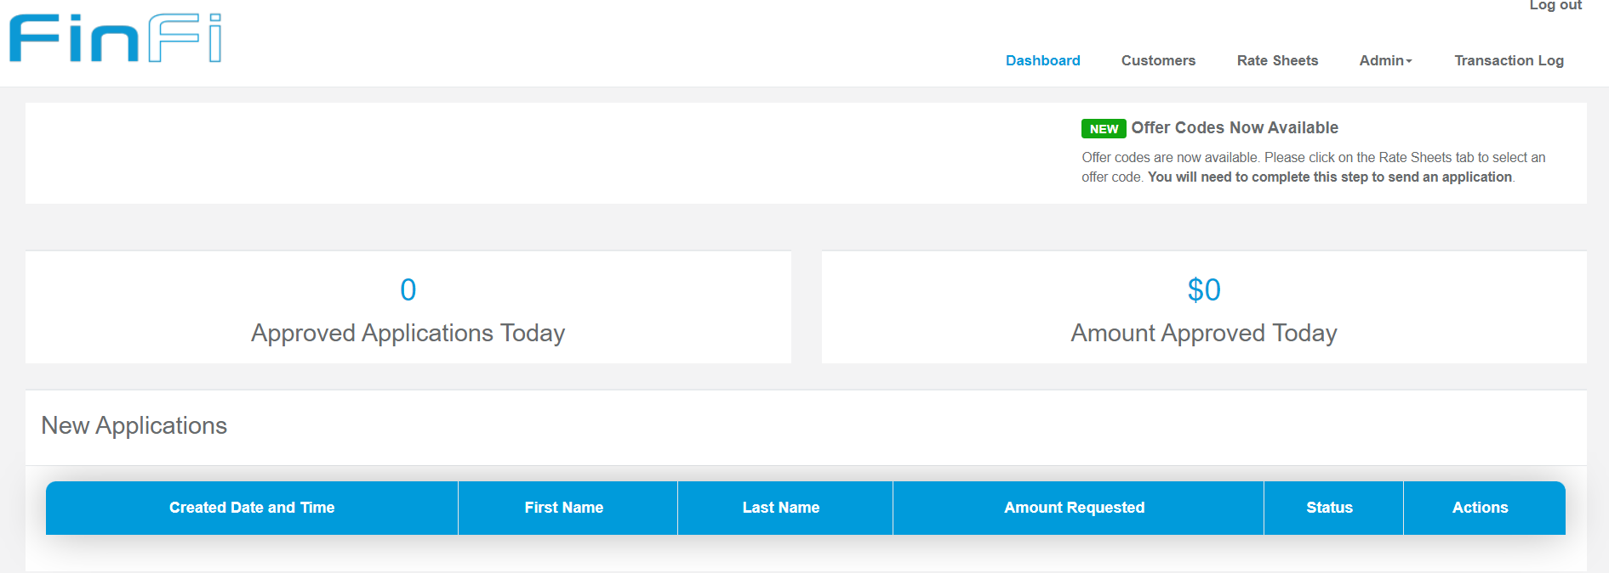

Offer Codes
Now the offer codes are available. Merchant creates Offers in Rate sheets.
Once the Rate Sheets are created he will see the ‘Send Application’ option at the right top corner.
He sends applications to customers.

Slide 23
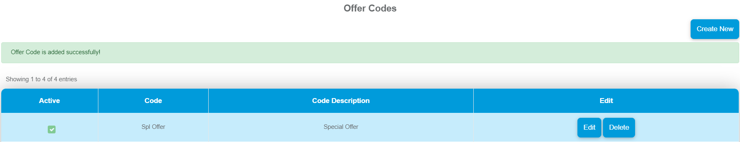
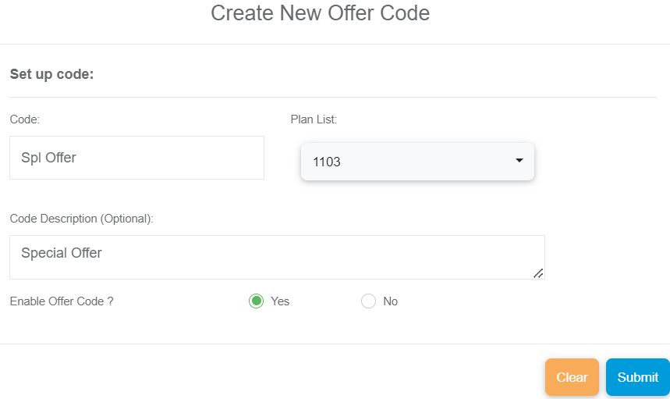
Creating New Offer Code

Slide 24
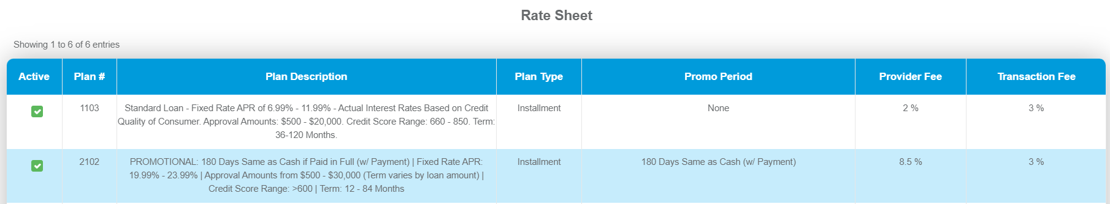
Rate Sheets

Slide 25
Thank you

